Slide 1

Information Retrieval using KNN and KD-Tree
MIS: 112003118 Rushikesh Neve

Slide 2
Project Details
K-Nearest Neighbour (KNN)
The K in KNN stands for the number of the nearest neighbors that the classifier will use to make its prediction.
We have training data with which we can predict the query data. For the query record which needs to be classified, the KNN algorithm computes the distance between the query record and all of the training data records. Then it looks at the K closest data records in the training data.
Data Structure :
KD-Tree
KNN Algorithm

Slide 3
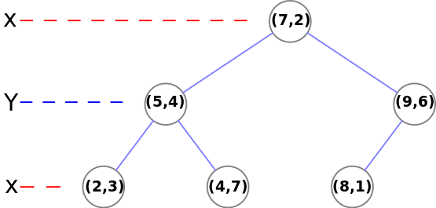
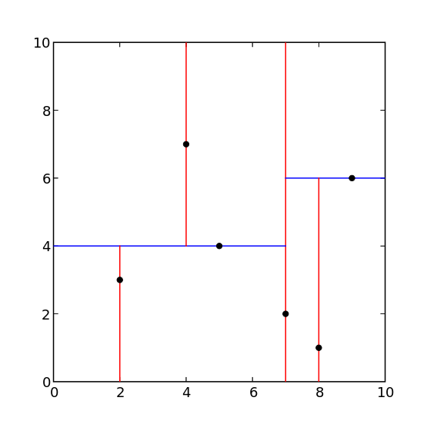
KD-Trees:
KDTree is a space partitioning data structure for organizing points in K-Dimensional space.
It is useful for representing data efficiently. In KDTree the data points are organized and partitioned on the basis of some specific conditions.

Slide 4
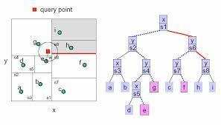
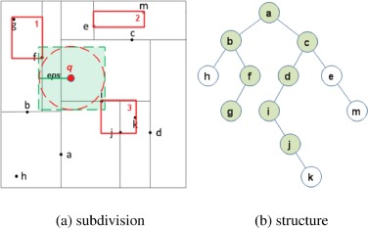
Find nearest neighbor using KD Tree

Slide 5
References:
https://kanoki.org/2020/08/05/find-nearest-neighbor-using-kd-tree
https://www.javatpoint.com/k-nearest-neighbor-algorithm-for-machine-learning
https://www.colorado.edu/amath/sites/default/files/attached-files/k-d_trees_and_knn_searches.pdf

